Slide 1

What’s your story?
Upholstery

Slide 2

What’s your story?
Water Park

Slide 3
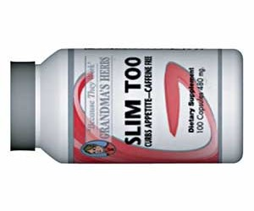
What’s your story?
Weight Loss Pills

Slide 4
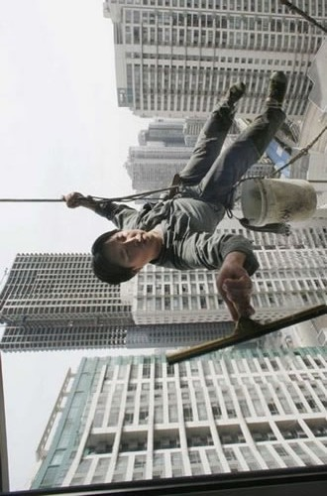
What’s your story?
Window Washer

Slide 5
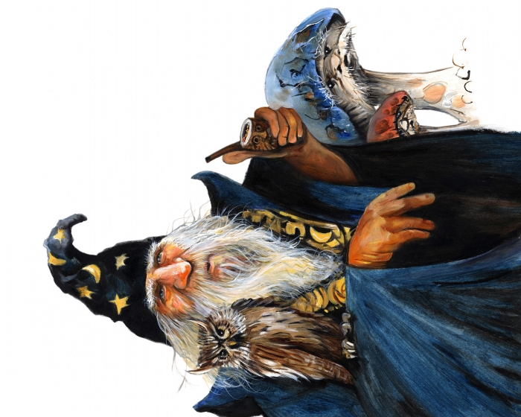
What’s your story?
Wizard

Slide 6

What’s your story?
YMCA

Slide 7
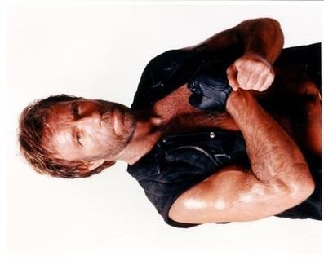
What’s your story?
Chuck Norris

Slide 8

What’s your story?
Harvard

Slide 9
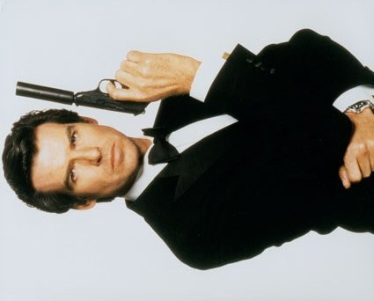
What’s your story?
James Bond

Slide 10

What’s your story?
Mansion

Slide 11
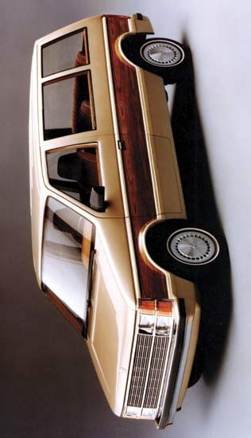
What’s your story?
Minivan

Slide 12
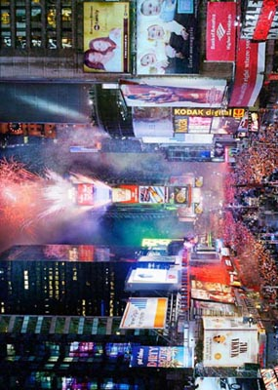
What’s your story?
New Year’s Eve

Slide 13

What’s your story?
Polka Dots

Slide 14
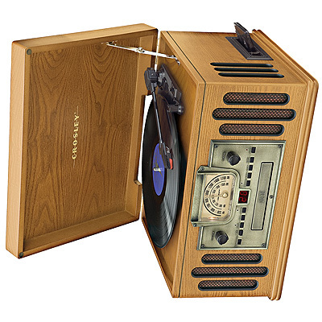
What’s your story?
Record Player

Slide 15

What’s your story?
Sand Castle

Slide 16
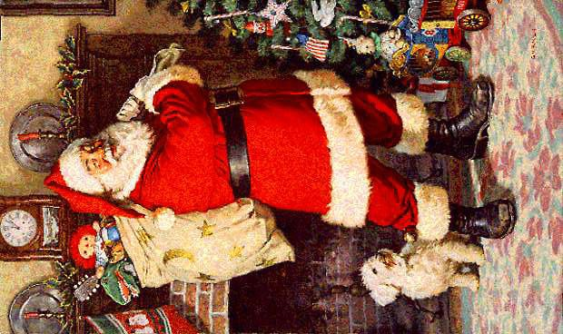
What’s your story?
Santa Claus

Slide 17
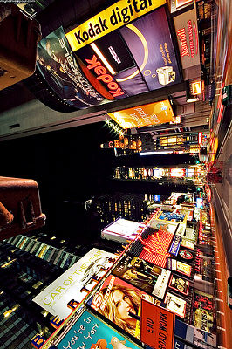
What’s your story?
Times Square

Slide 18
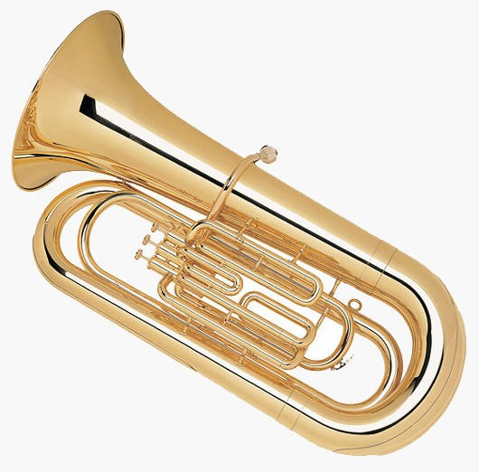
What’s your story?
Tuba

Slide 19
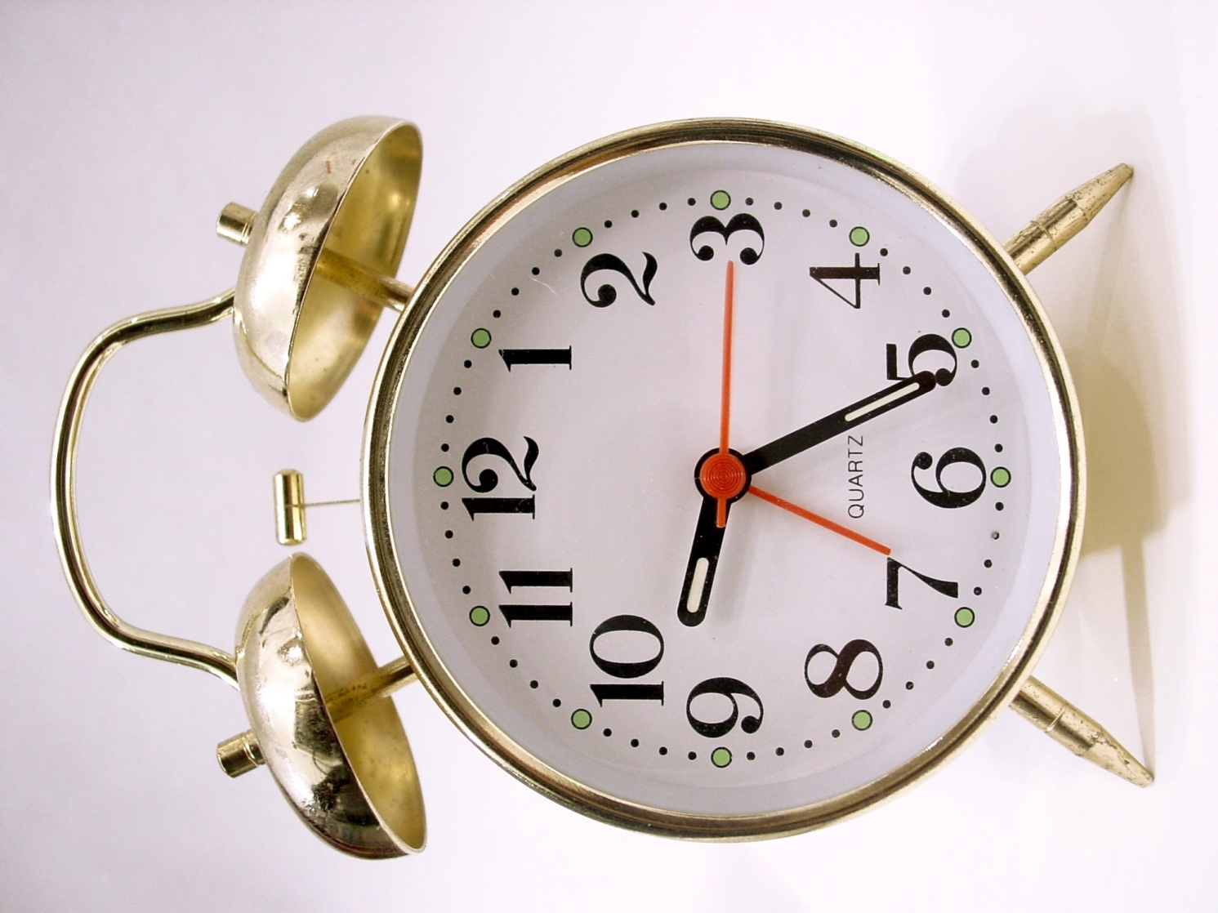
What’s your story?
Alarm Clock

Slide 20

What’s your story?
Army

Slide 21

What’s your story?
Bakery

Slide 22

What’s your story?
Balloons

Slide 23
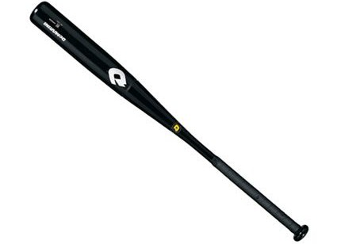
What’s your story?
Baseball Bat

Slide 24

What’s your story?
Bomb

Slide 25
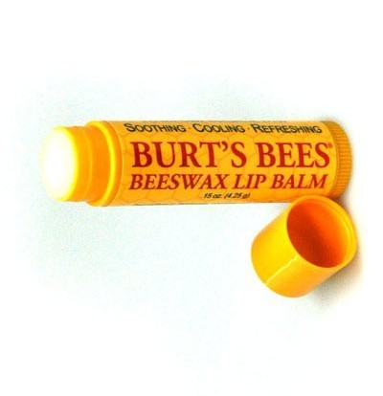
What’s your story?
Burt’s Bees Chapstick

Slide 26

What’s your story?
Candles

Slide 27

What’s your story?
Caution Tape

Slide 28
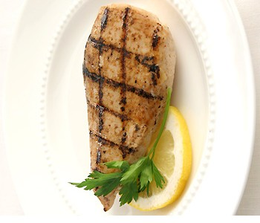
What’s your story?
Chicken Breast

Slide 29

What’s your story?
Clouds

Slide 30
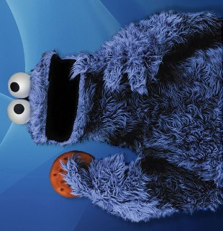
What’s your story?
Cookie Monster

Slide 31

What’s your story?
Cupcakes

Slide 32

What’s your story?
Deodorant

Slide 33
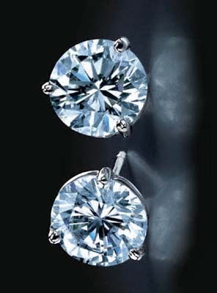
What’s your story?
Earrings

Slide 34
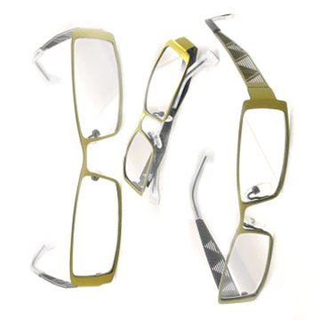
What’s your story?
Eyeglasses

Slide 35
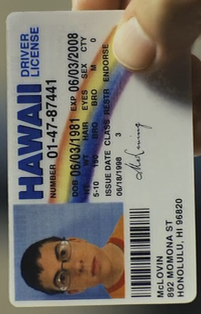
What’s your story?
Fake ID

Slide 36

What’s your story?
Fragrance

Slide 37
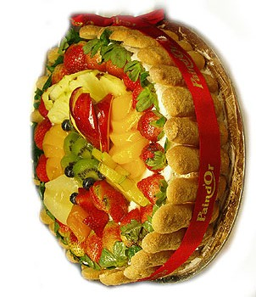
What’s your story?
Fruit Cake

Slide 38

What’s your story?
Golf

Slide 39
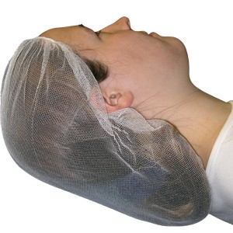
What’s your story?
Hairnet

Slide 40
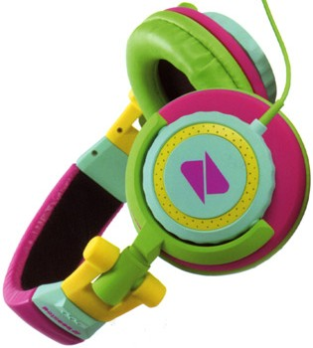
What’s your story?
Headphones

Slide 41
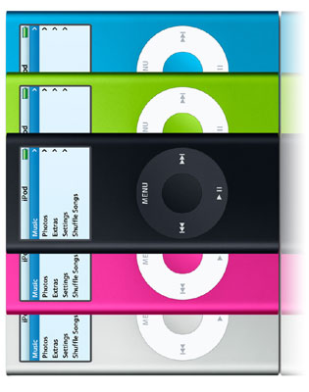
What’s your story?
iPod

Slide 42

What’s your story?
Jail

Slide 43

What’s your story?
Kim Kardashian

Slide 44
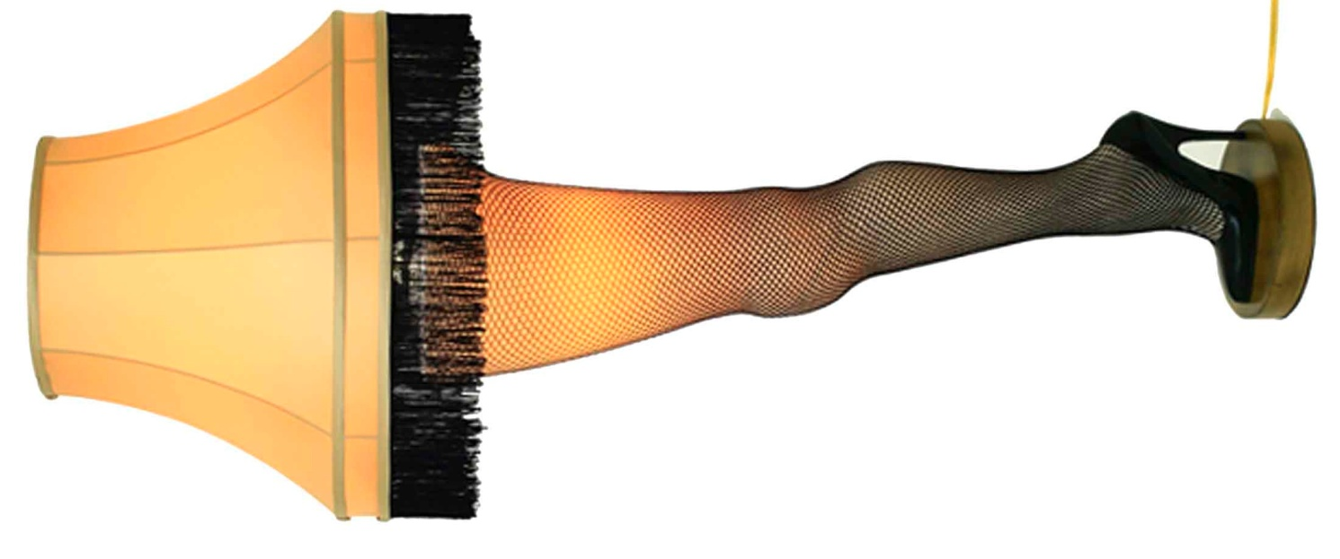
What’s your story?
Lamp

Slide 45
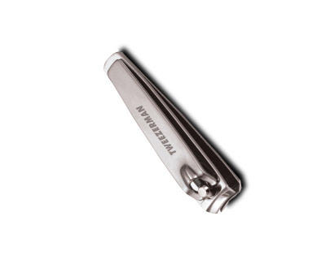
What’s your story?
Nail Clippers

Slide 46
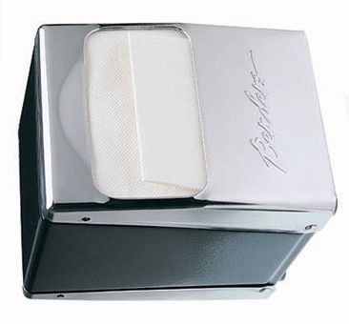
What’s your story?
Napkins

Slide 47
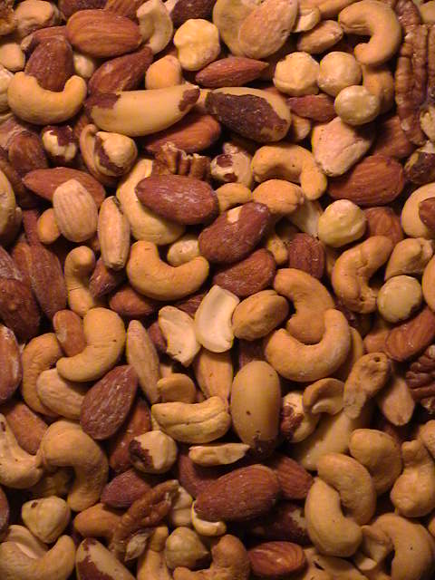
What’s your story?
Nuts

Slide 48

What’s your story?
Oranges

Slide 49
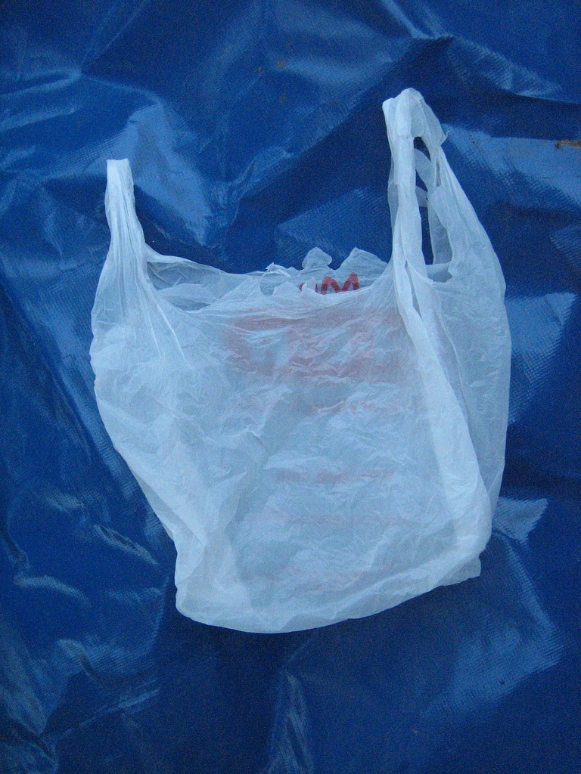
What’s your story?
Plastic Bag

Slide 50

What’s your story?
Poster

Slide 51
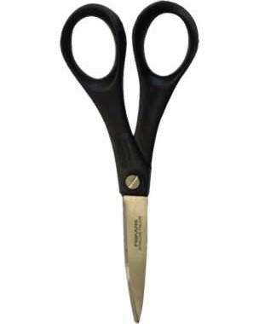
What’s your story?
Scissors

Slide 52
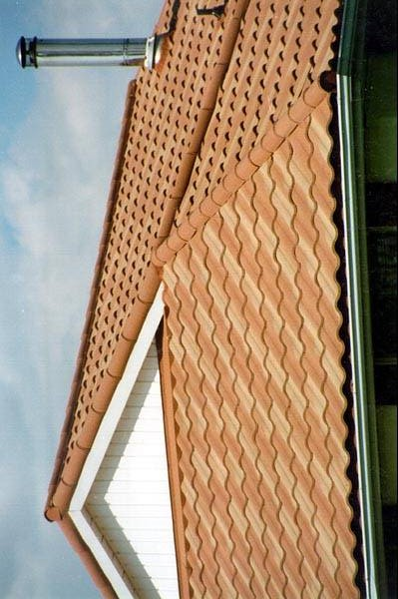
What’s your story?
Roof

Slide 53
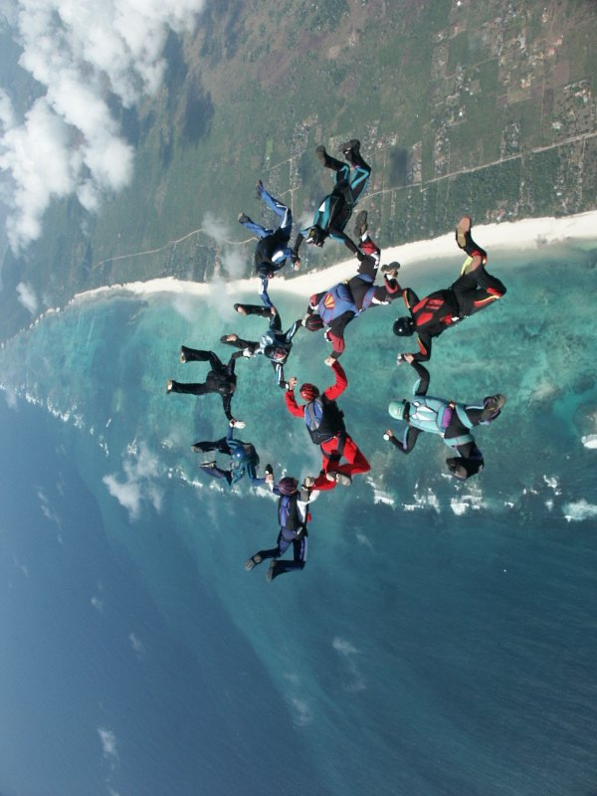
What’s your story?
Skydiving

Slide 54
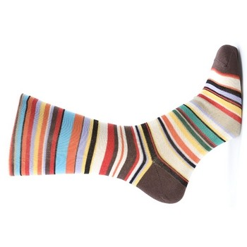
What’s your story?
Socks

Slide 55

What’s your story?
Sponge

Slide 56
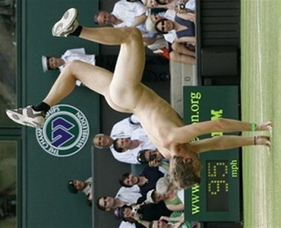
What’s your story?
Streaker

Slide 57
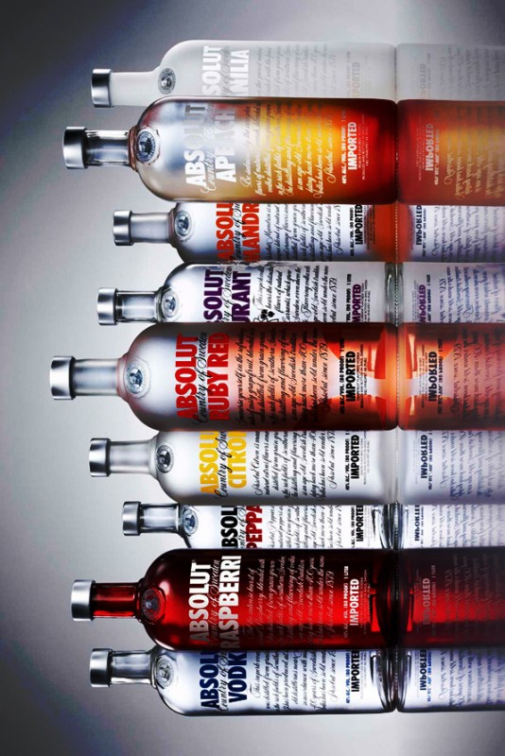
What’s your story?
Vodka

Slide 58
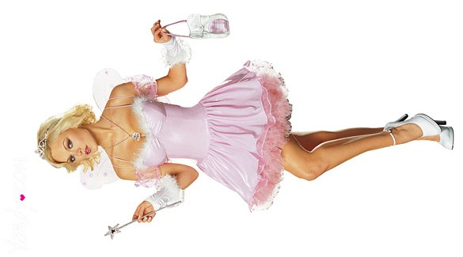
What’s your story?
Tooth Fairy

Slide 59
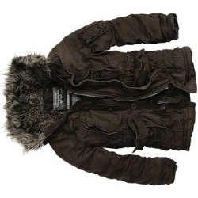
What’s your story?
Winter Coat

Slide 60

What’s your story?
Ron Burgundy

