Slide 1
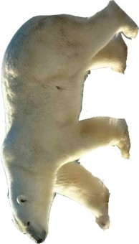
What’s your story?
Polar Bear

Slide 2

What’s your story?
Johnny Depp

Slide 3

What’s your story?
Handcuffs

Slide 4
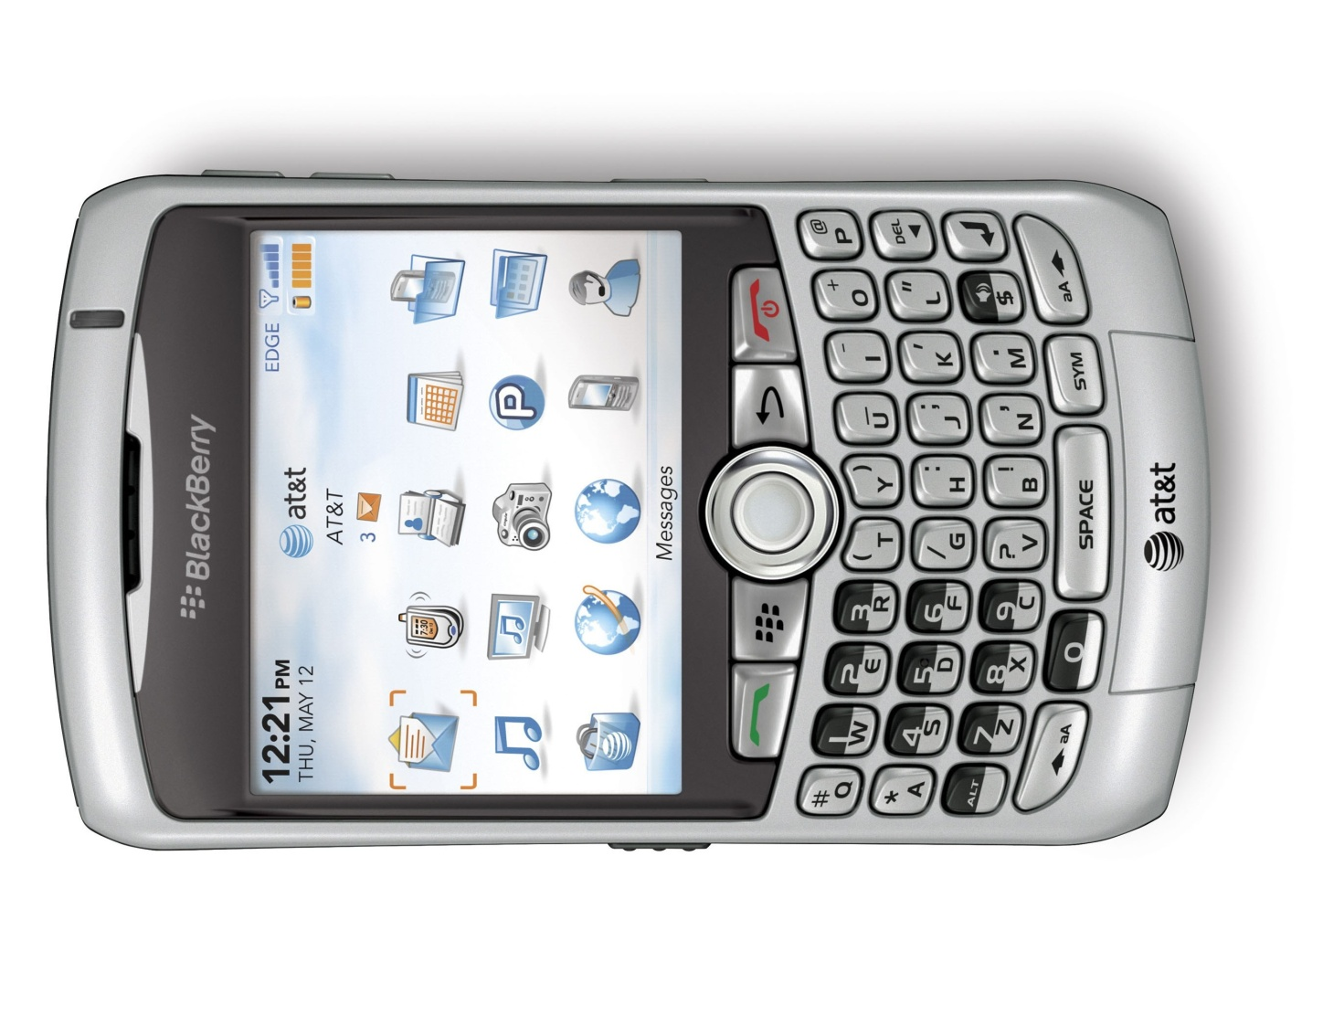
What’s your story?
Blackberry

Slide 5
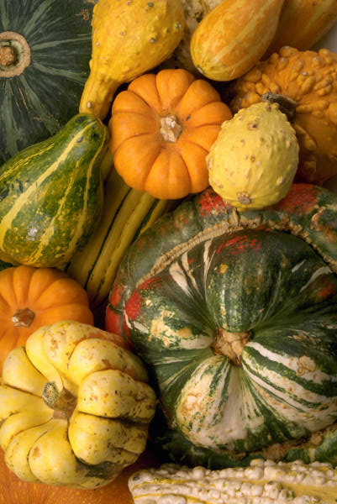
What’s your story?
Squash

Slide 6
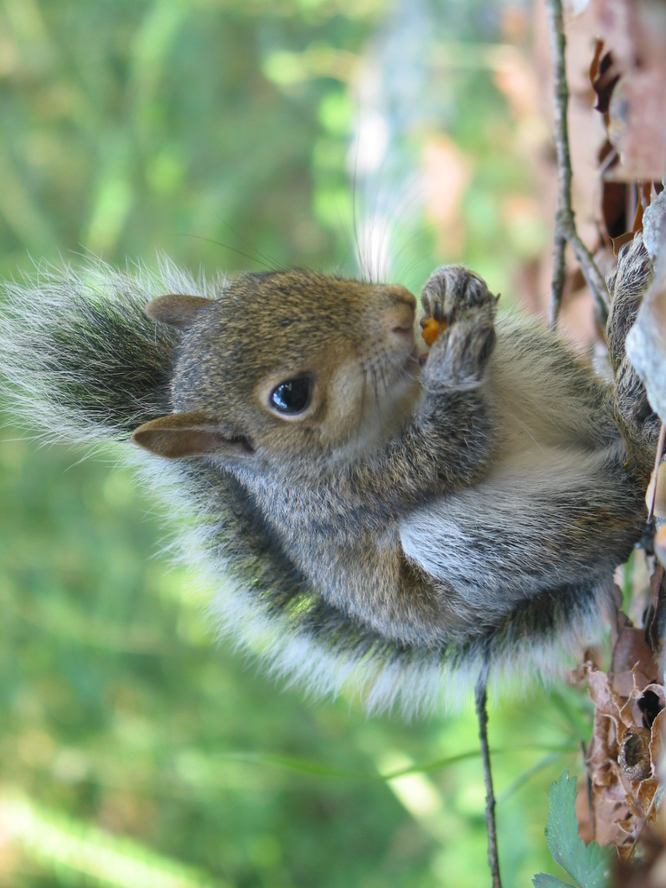
What’s your story?
Squirrel

Slide 7
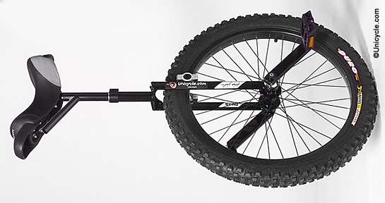
What’s your story?
Unicycle

Slide 8
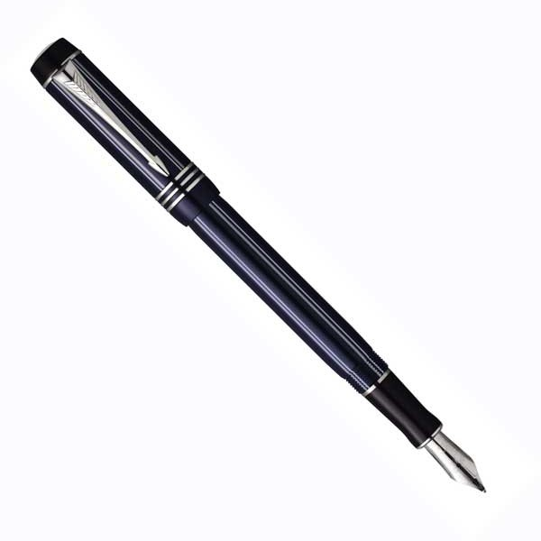
What’s your story?
Fountain Pen

Slide 9
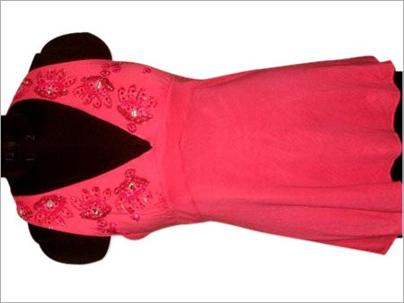
What’s your story?
Halter Top

Slide 10
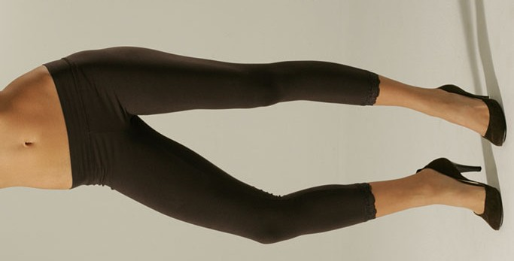
What’s your story?
Leggings

Slide 11

What’s your story?
Rutgers

Slide 12
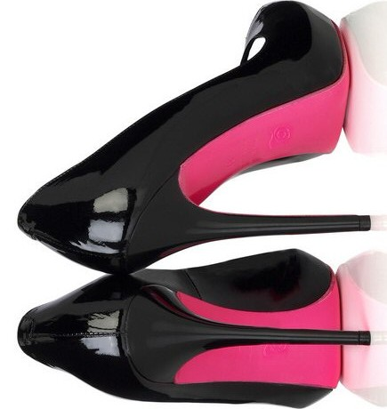
What’s your story?
Stilettos

Slide 13
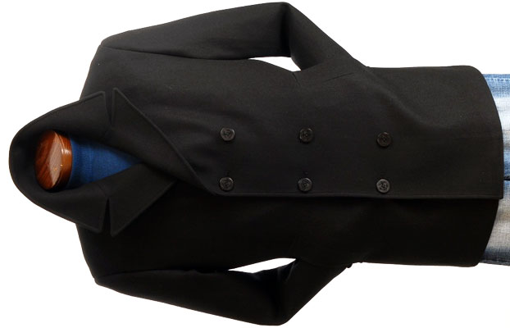
What’s your story?
Peacoat

Slide 14

What’s your story?
Grapefruit

Slide 15
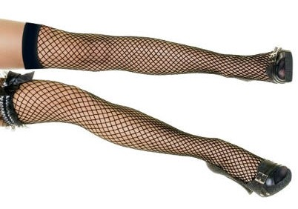
What’s your story?
Fishnets

Slide 16
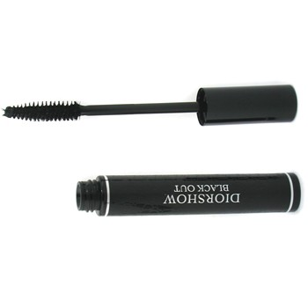
What’s your story?
Mascara

Slide 17

What’s your story?
North Pole

Slide 18
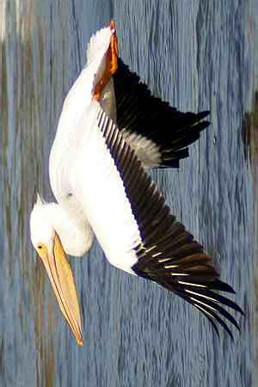
What’s your story?
Pelican

Slide 19

What’s your story?
Oprah Winfrey

Slide 20
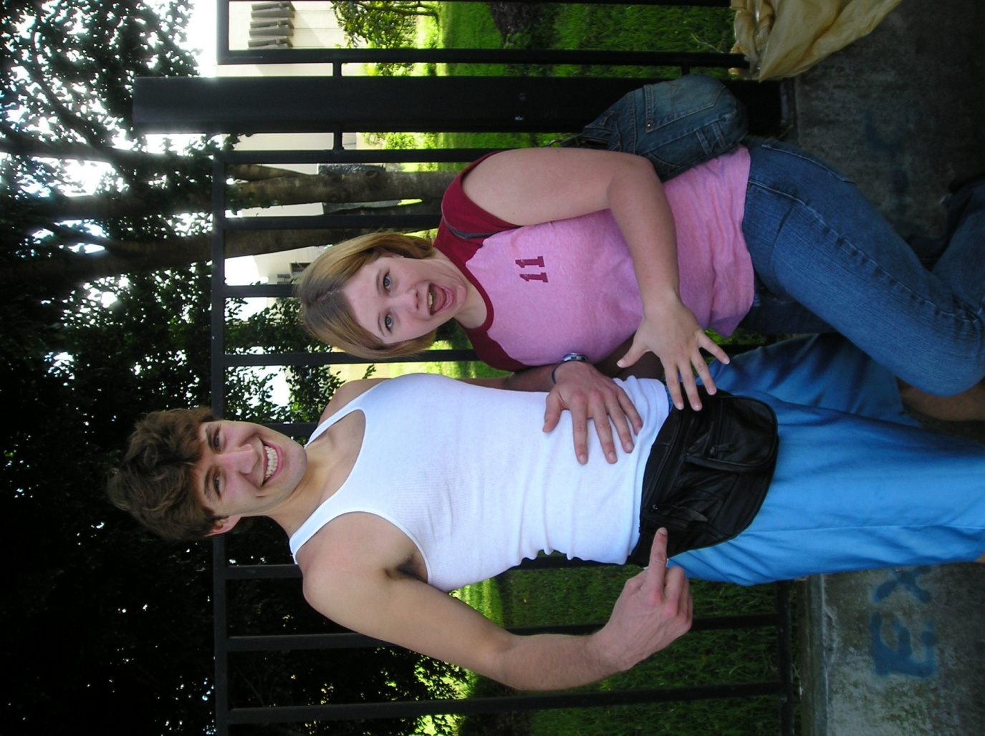
What’s your story?
Fanny Pack

Slide 21
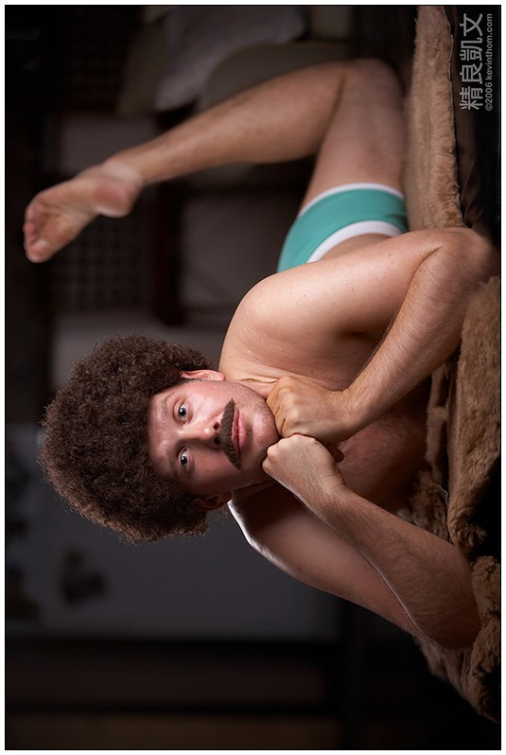
What’s your story?
Afro

Slide 22
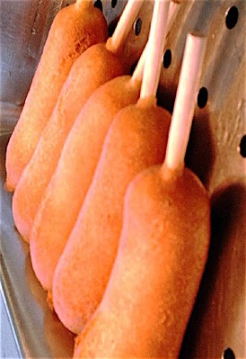
What’s your story?
Corndog

Slide 23

What’s your story?
Mistle Toe

Slide 24
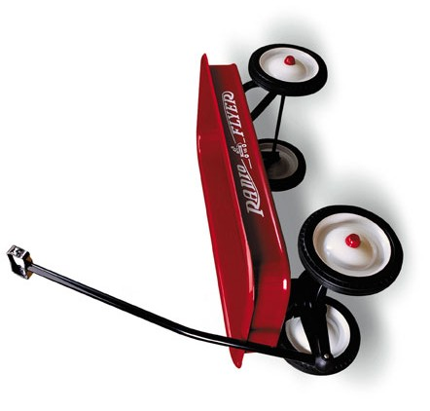
What’s your story?
Wagon

Slide 25
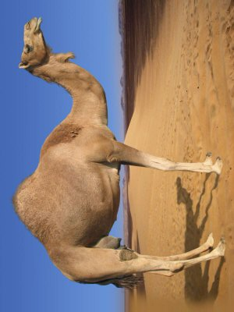
What’s your story?
Camel

Slide 26

What’s your story?
Water Bottle

Slide 27
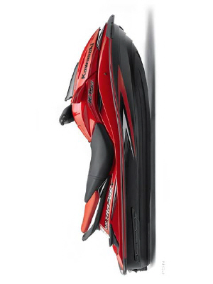
What’s your story?
Jet Ski

Slide 28

What’s your story?
Grandmother

Slide 29

What’s your story?
Gang

Slide 30
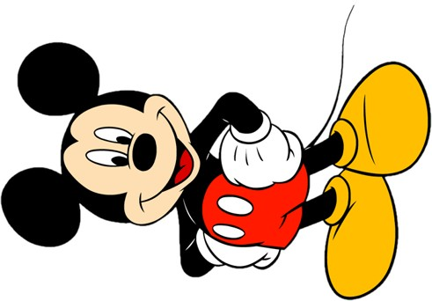
What’s your story?
Mickey Mouse

Slide 31
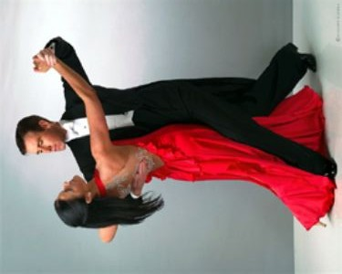
What’s your story?
Dance

Slide 32

What’s your story?
Valentine’s Card

Slide 33
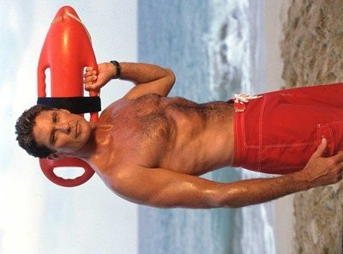
What’s your story?
Lifeguard

Slide 34

What’s your story?
Hot Date

Slide 35
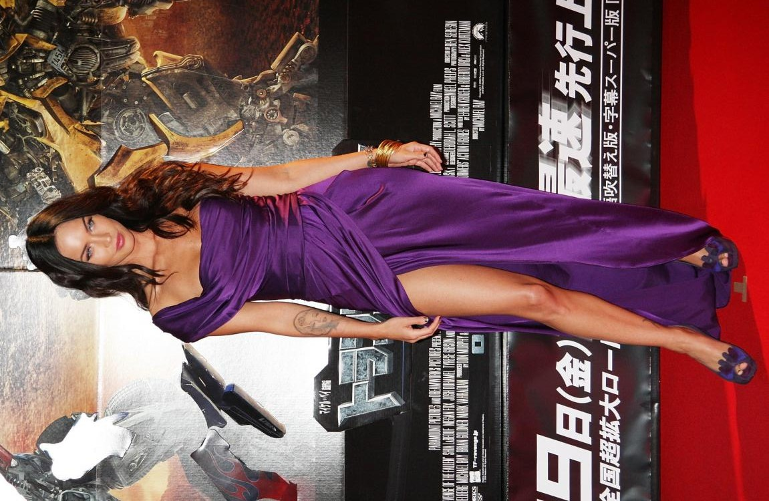
What’s your story?
Megan Fox

Slide 36
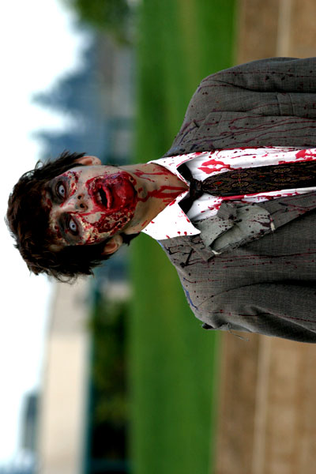
What’s your story?
Zombie

Slide 37
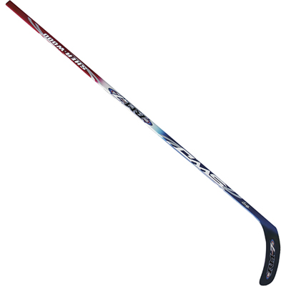
What’s your story?
Hockey Stick

Slide 38
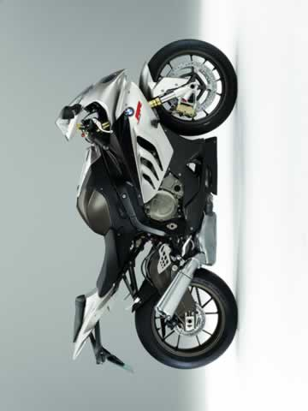
What’s your story?
Motorcycle

Slide 39
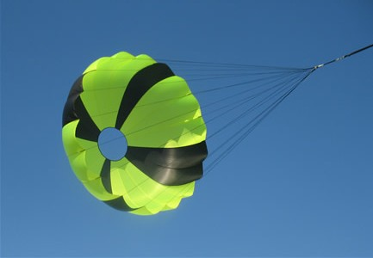
What’s your story?
Parachute

Slide 40
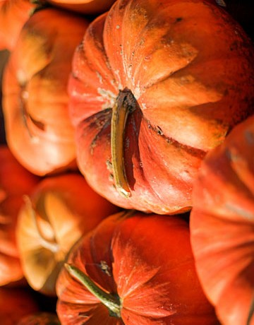
What’s your story?
Pumpkin

Slide 41
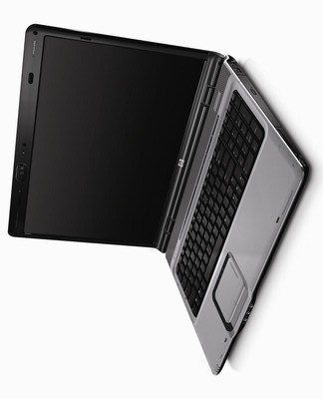
What’s your story?
Laptop

Slide 42

What’s your story?
KFC

Slide 43
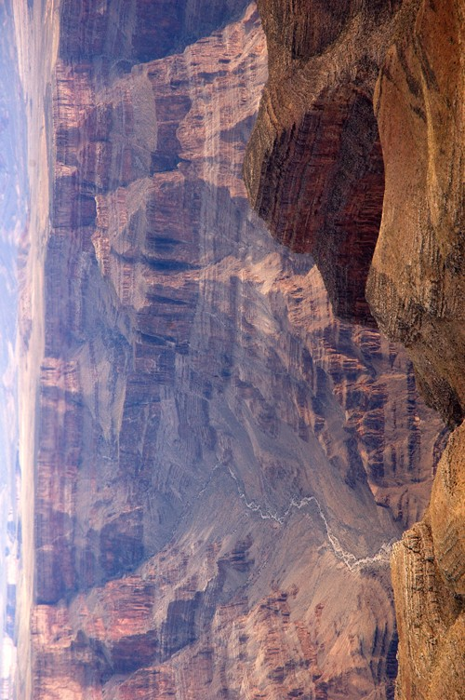
What’s your story?
Grand Canyon

Slide 44
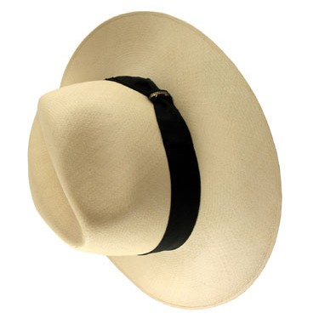
What’s your story?
Hat

Slide 45
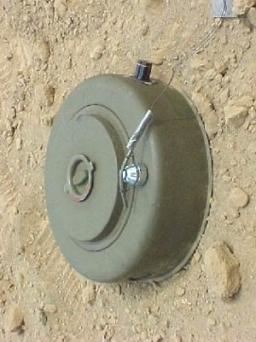
What’s your story?
Landmine

Slide 46
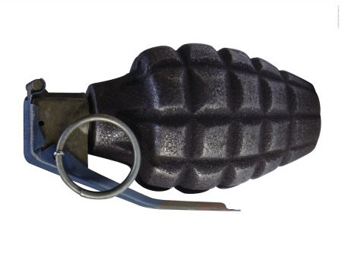
What’s your story?
Grenade

Slide 47

What’s your story?
Taco Bell

Slide 48
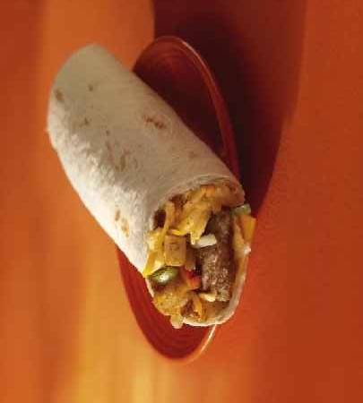
What’s your story?
Burrito

Slide 49

What’s your story?
Pokemon

Slide 50
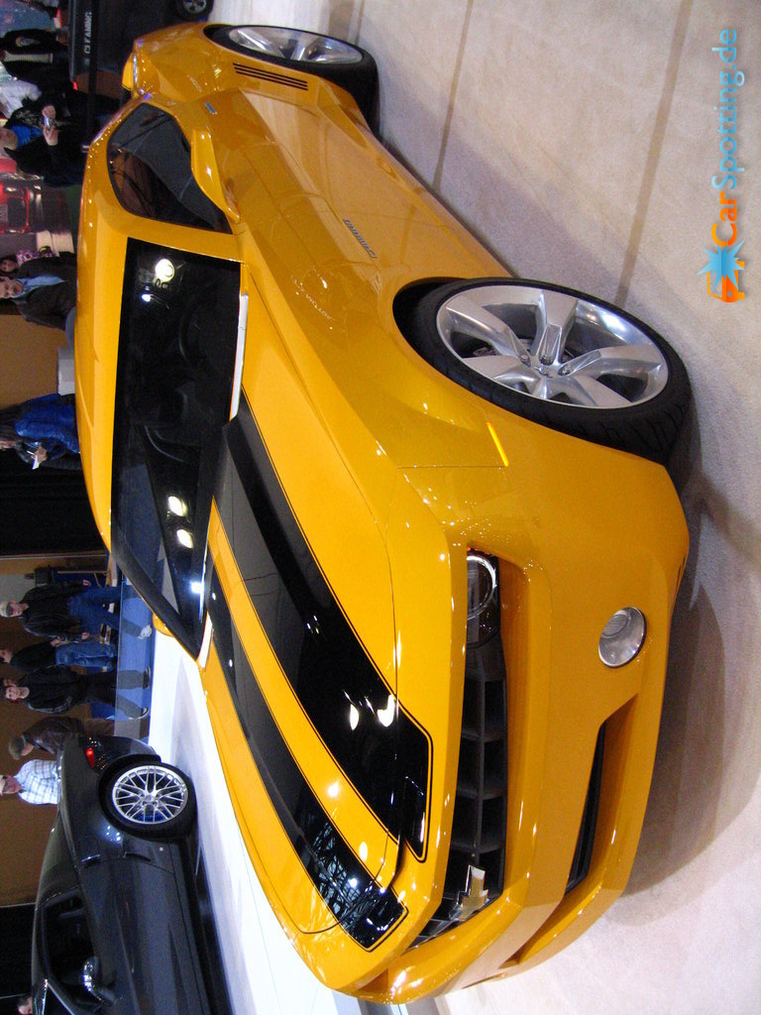
What’s your story?
Camaro

