Slide 1
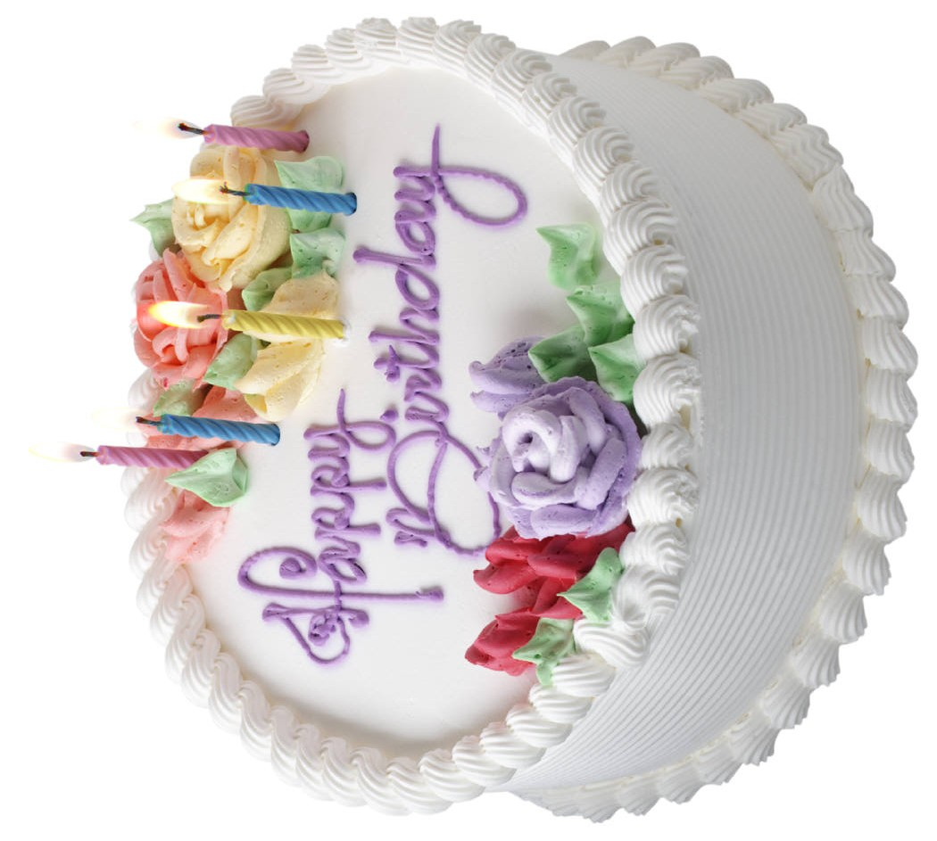
What’s your story?
Birthday Cake

Slide 2

What’s your story?
The Brave Little Toaster

Slide 3
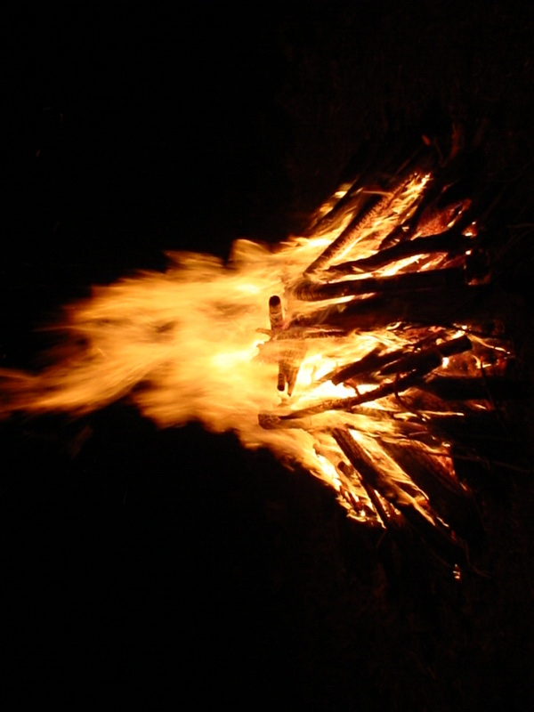
What’s your story?
Campfire

Slide 4
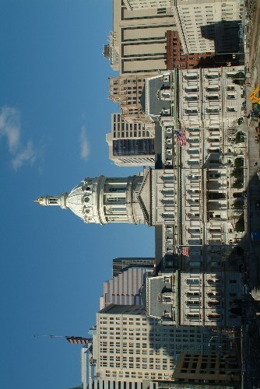
What’s your story?
City Hall

Slide 5
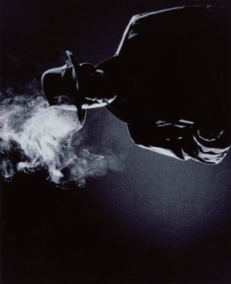
What’s your story?
Detective

Slide 6
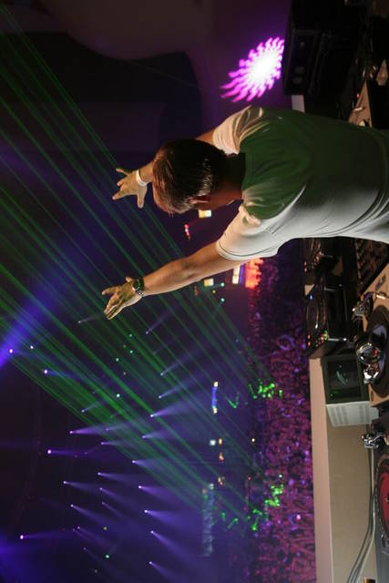
What’s your story?
Disc Jockey

Slide 7
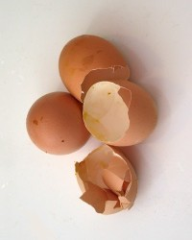
What’s your story?
Egg Shells

Slide 8
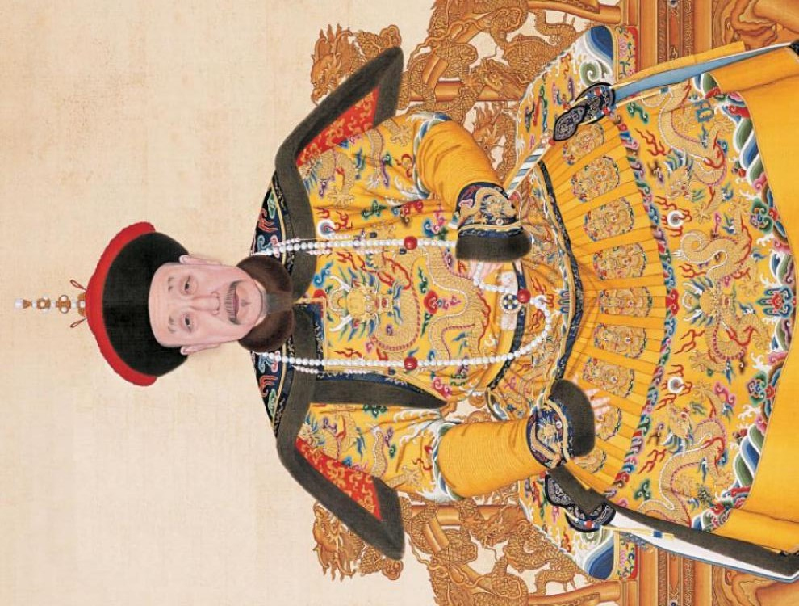
What’s your story?
Emperor

Slide 9
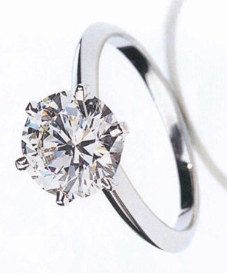
What’s your story?
Engagement Ring

Slide 10

What’s your story?
Expository Writing

Slide 11
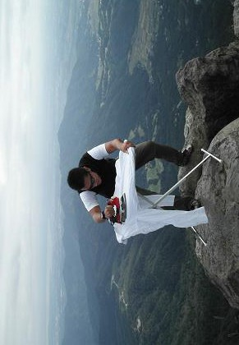
What’s your story?
Extreme Ironing

Slide 12
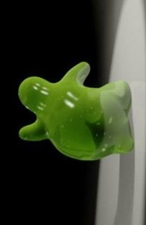
What’s your story?
Flubber

Slide 13
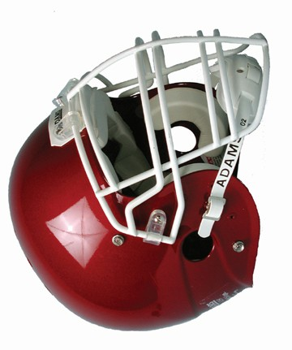
What’s your story?
Football Helmet

Slide 14
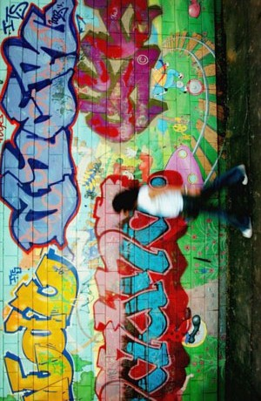
What’s your story?
Graffiti

Slide 15

What’s your story?
Hospital

Slide 16
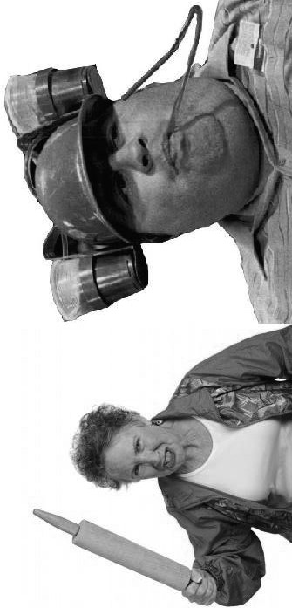
What’s your story?
In-Laws

Slide 17
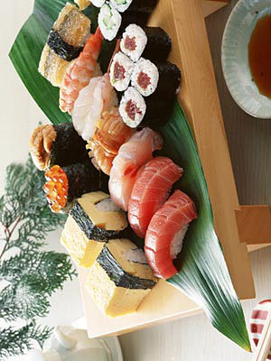
What’s your story?
Japanese Food

Slide 18
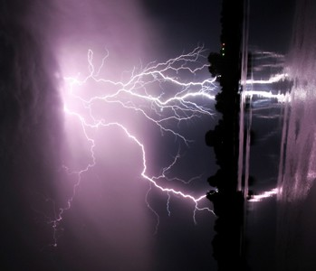
What’s your story?
Lightning

Slide 19
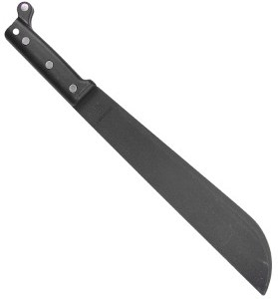
What’s your story?
Machete

Slide 20
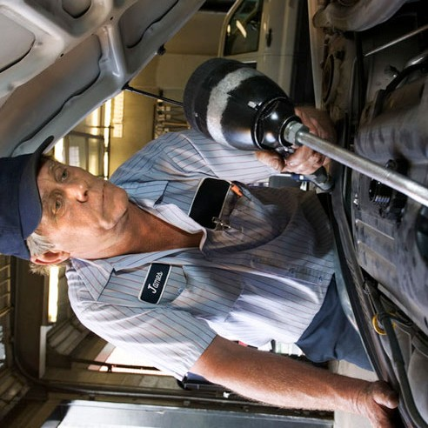
What’s your story?
Mechanic

Slide 21
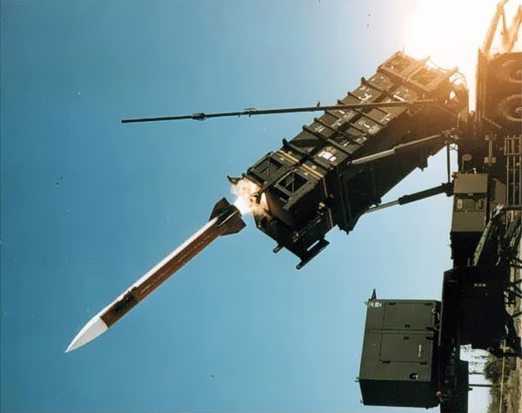
What’s your story?
Missile Defense System

Slide 22
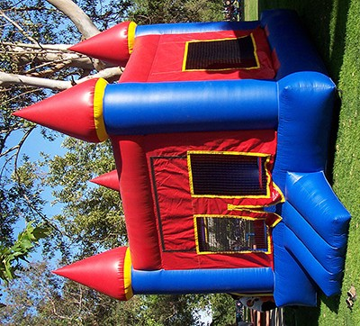
What’s your story?
Moon Bounce

Slide 23
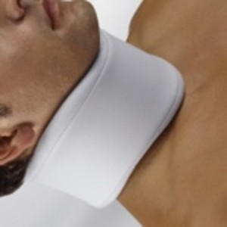
What’s your story?
Neckbrace

Slide 24
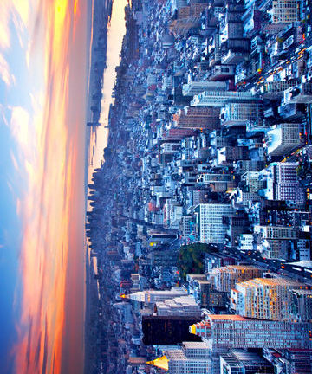
What’s your story?
New York City

Slide 25

What’s your story?
Ninja

Slide 26

What’s your story?
Olympics

Slide 27
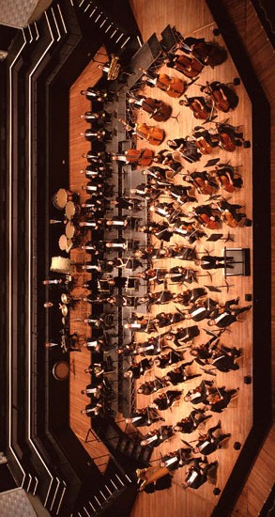
What’s your story?
Orchestra

Slide 28
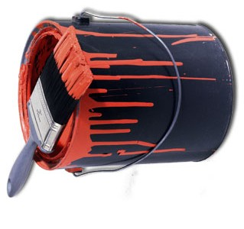
What’s your story?
Paint Can

Slide 29

What’s your story?
Paper Weight

Slide 30

What’s your story?
Photoshop

Slide 31
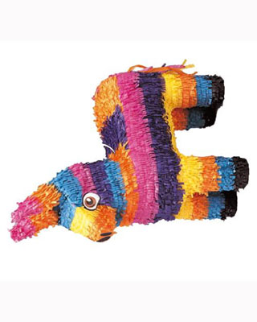
What’s your story?
Piñata

Slide 32

What’s your story?
Poison

Slide 33
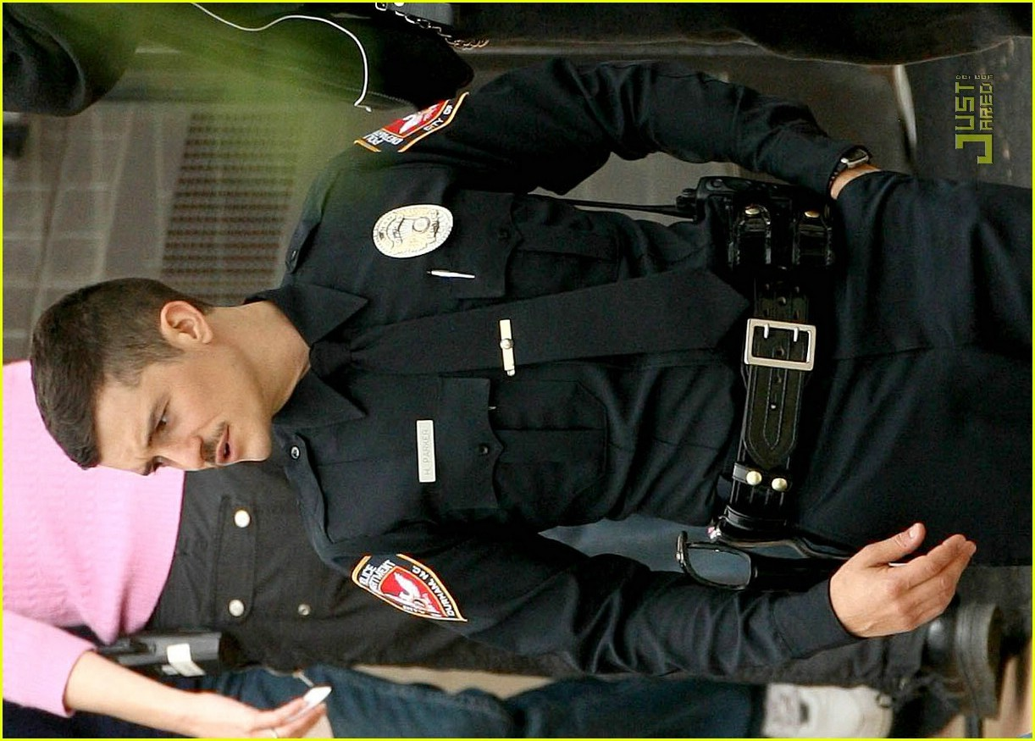
What’s your story?
Police Officer

Slide 34
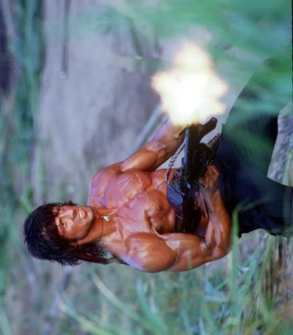
What’s your story?
Rambo

Slide 35
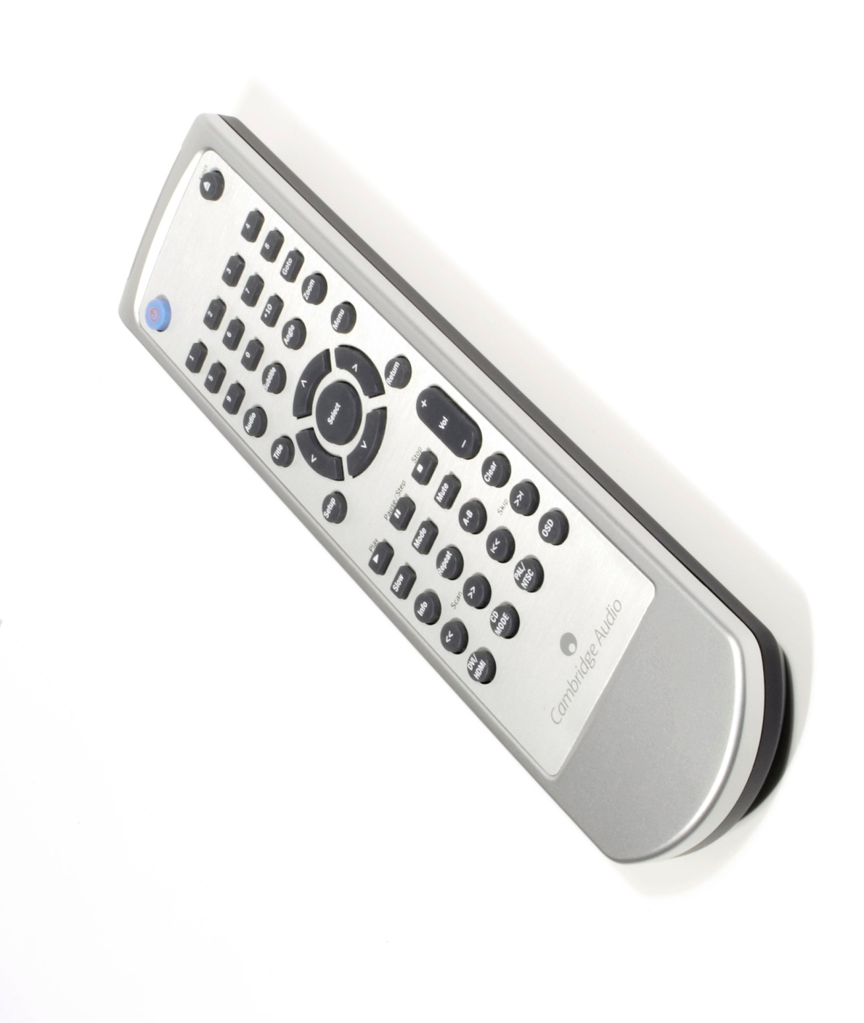
What’s your story?
Remote Control

Slide 36
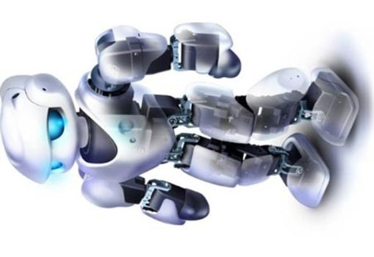
What’s your story?
Robot

Slide 37
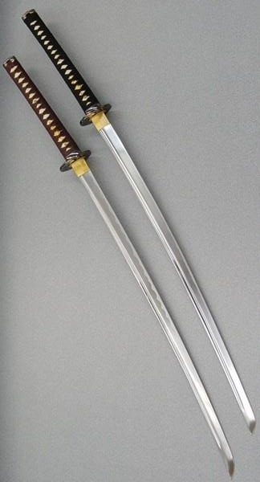
What’s your story?
Samurai Sword

Slide 38
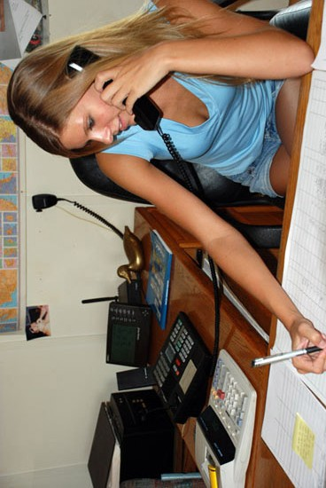
What’s your story?
Administrative Assistant

Slide 39
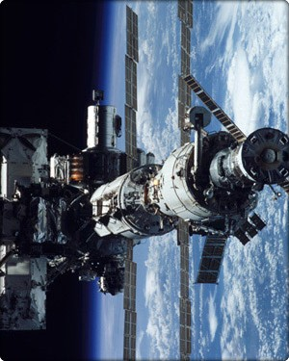
What’s your story?
Space Station

Slide 40
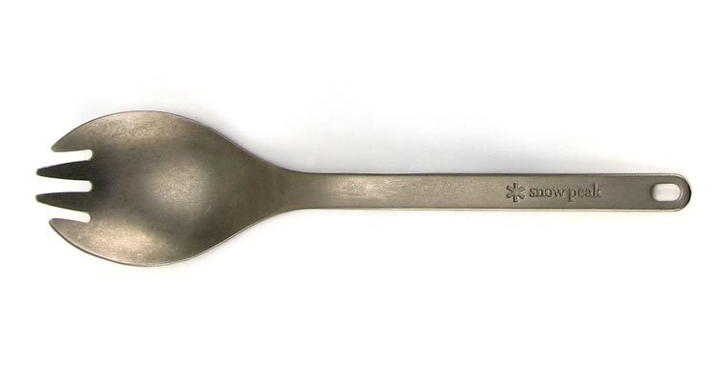
What’s your story?
Spork

Slide 41
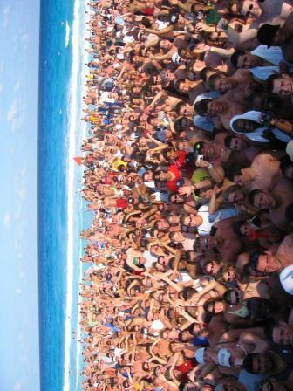
What’s your story?
Spring Break

Slide 42
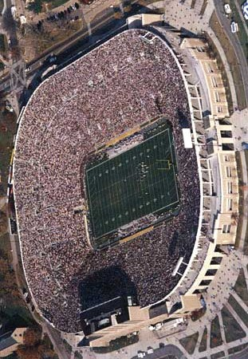
What’s your story?
Stadium

Slide 43
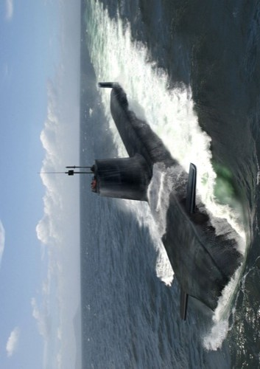
What’s your story?
Submarine

Slide 44
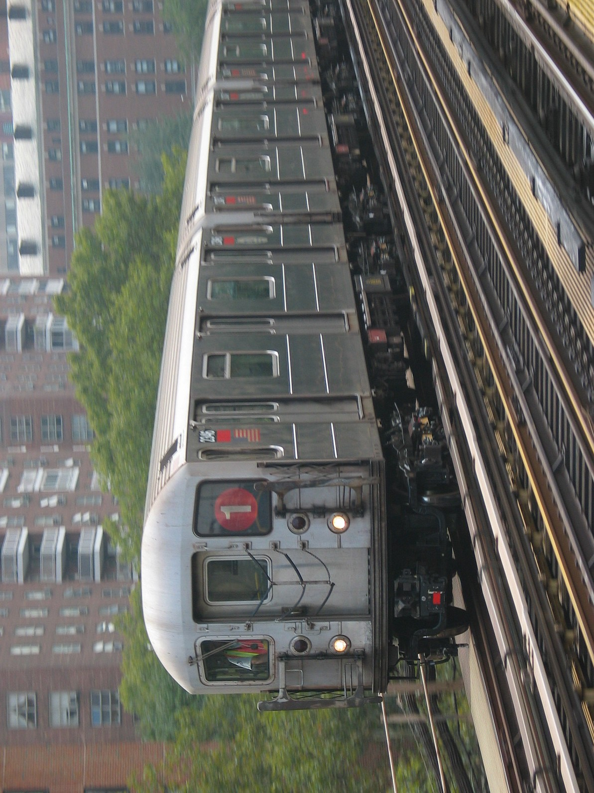
What’s your story?
Subway Train

Slide 45
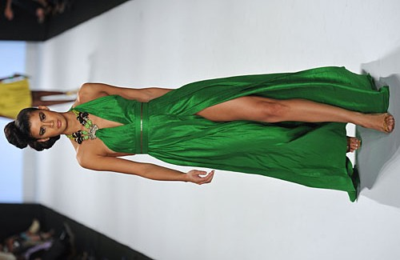
What’s your story?
Model

Slide 46
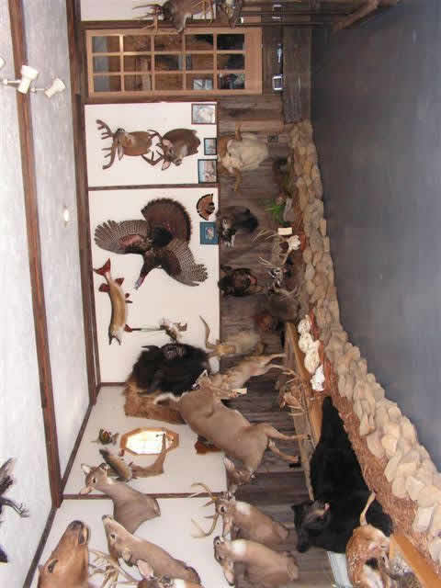
What’s your story?
Taxidermy

Slide 47
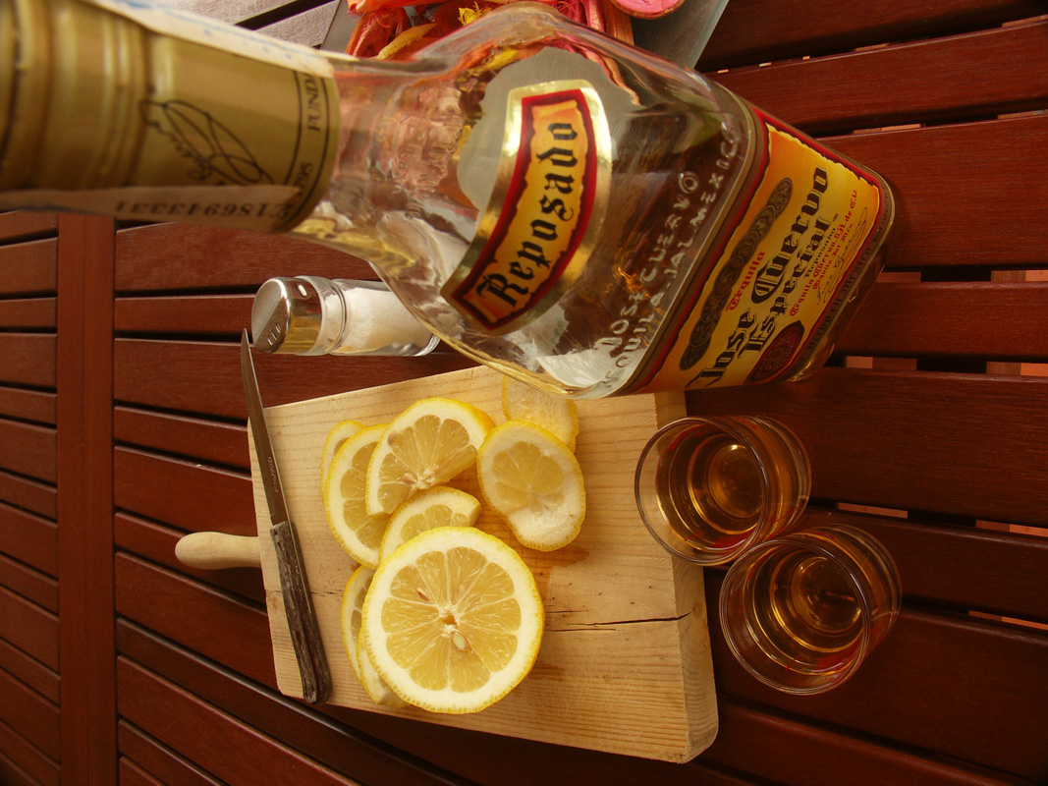
What’s your story?
Tequila

Slide 48
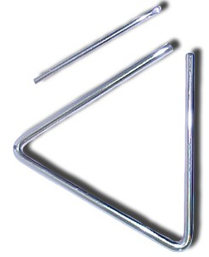
What’s your story?
Triangle

