Slide 1
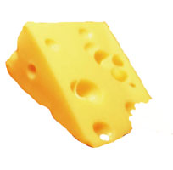
What’s your story?
Swiss Cheese

Slide 2
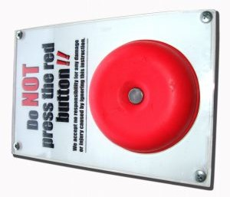
What’s your story?
Big, Red Button

Slide 3
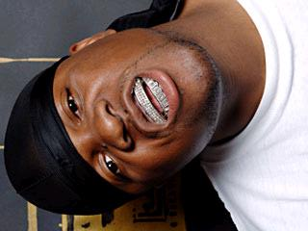
What’s your story?
Mike Jones

Slide 4
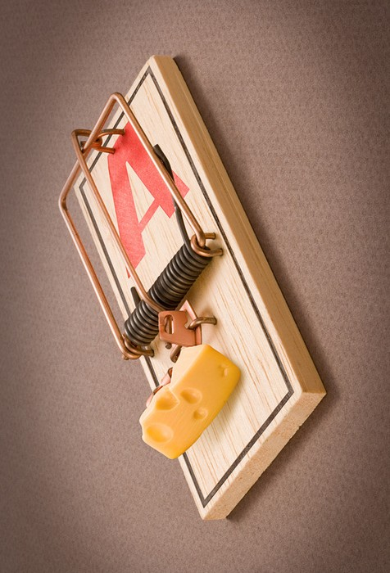
What’s your story?
Mouse Trap

Slide 5
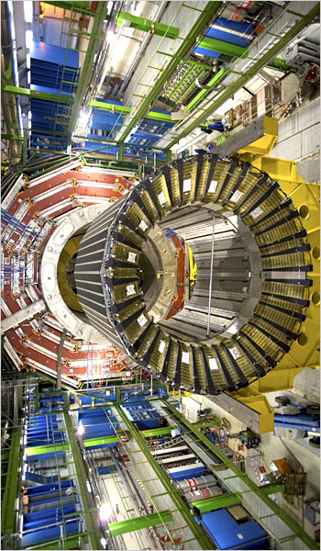
What’s your story?
Particle Accelerator

Slide 6
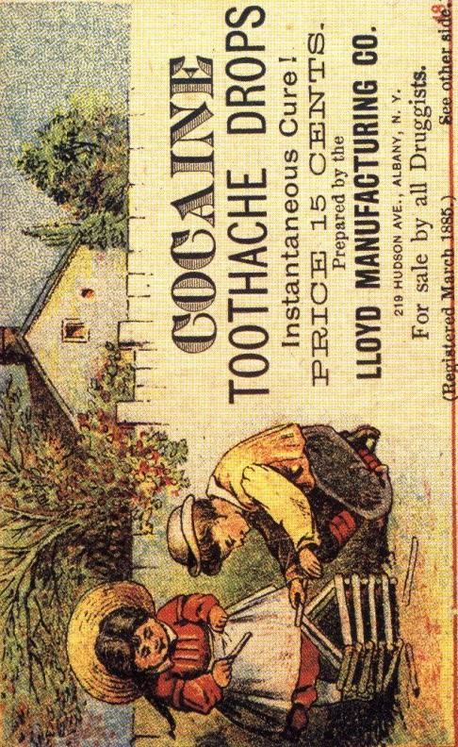
What’s your story?
Advertisement

Slide 7
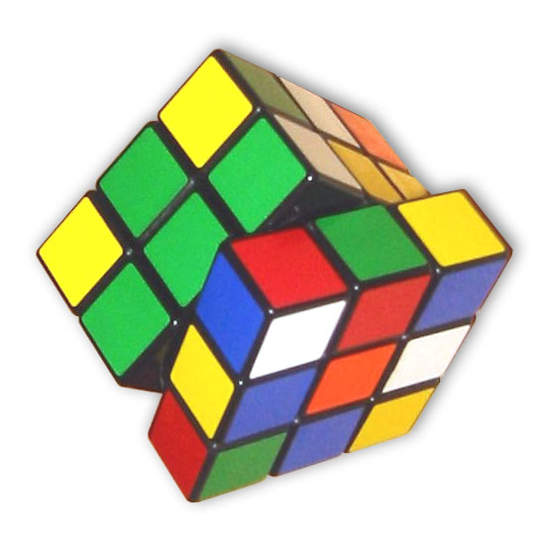
What’s your story?
Rubik’s Cube

Slide 8
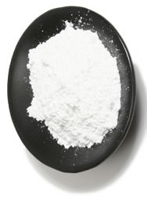
What’s your story?
Powdered Sugar

Slide 9
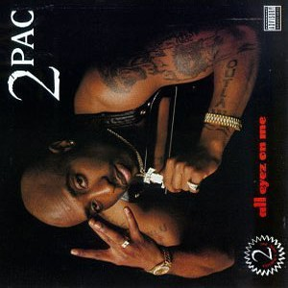
What’s your story?
Tupac

Slide 10
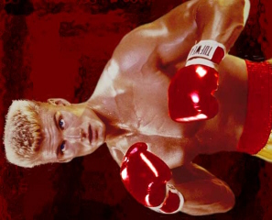
What’s your story?
Ivan Drago

Slide 11
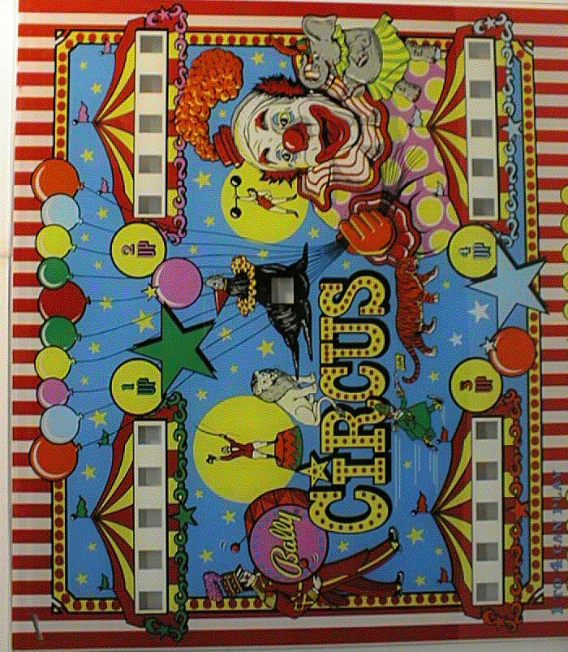
What’s your story?
Circus

Slide 12
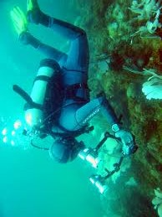
What’s your story?
Deep-Sea Diving

Slide 13
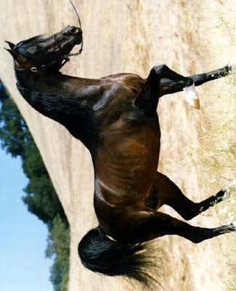
What’s your story?
Horse

Slide 14
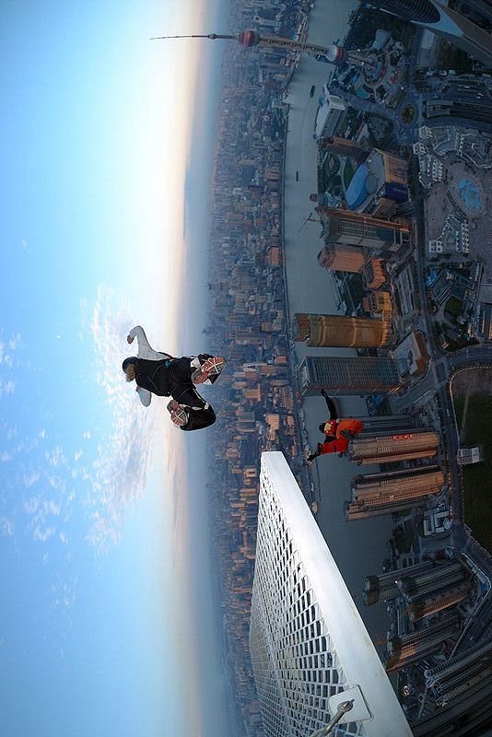
What’s your story?
BASE Jumping

Slide 15
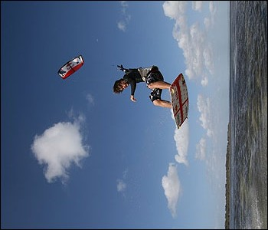
What’s your story?
Kite Surfing

Slide 16
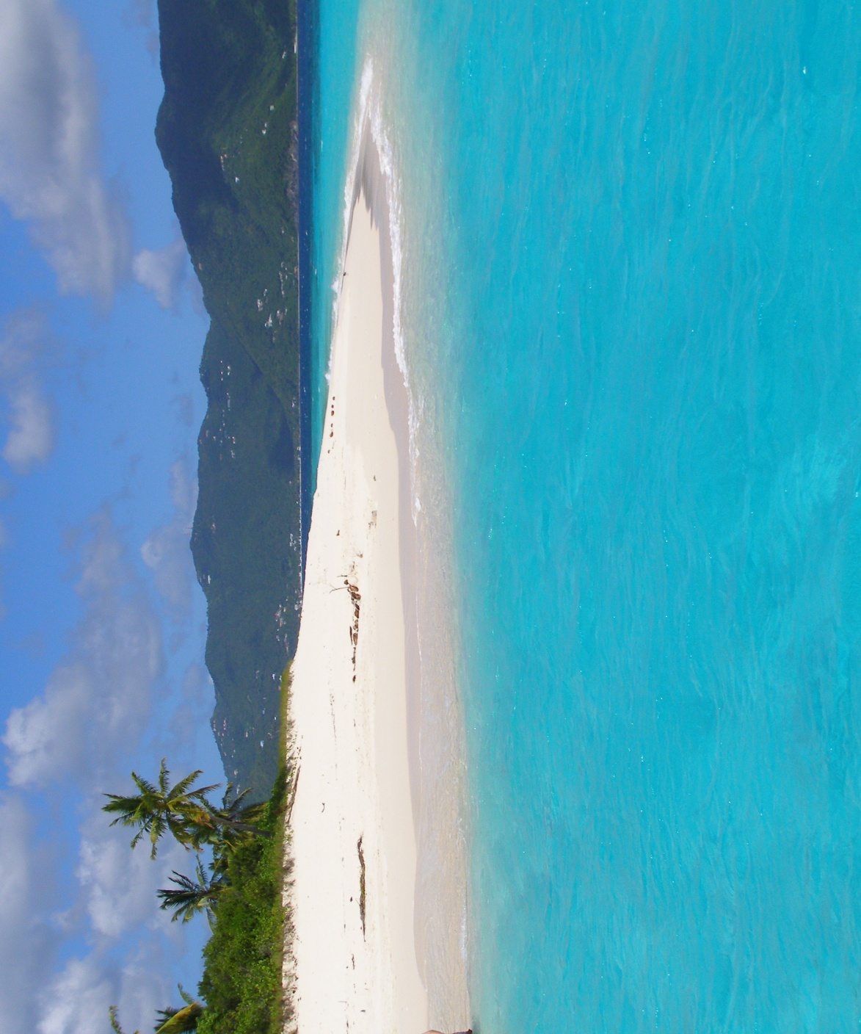
What’s your story?
Beach

Slide 17
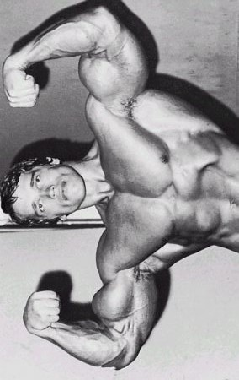
What’s your story?
Body Builder

Slide 18
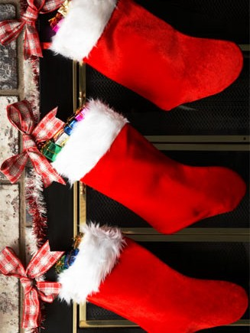
What’s your story?
Stockings

Slide 19
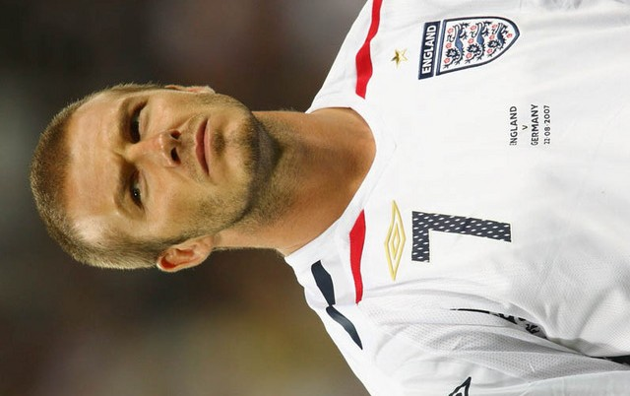
What’s your story?
David Beckham

Slide 20

What’s your story?
Facebook Status

Slide 21
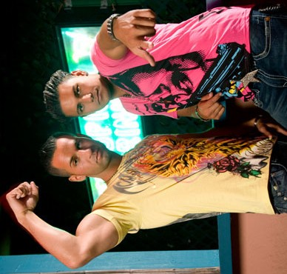
What’s your story?
Fist Pump

Slide 22
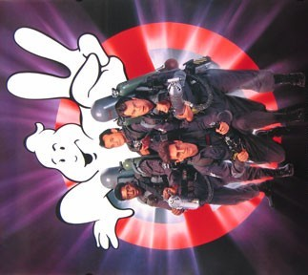
What’s your story?
Ghostbusters

Slide 23
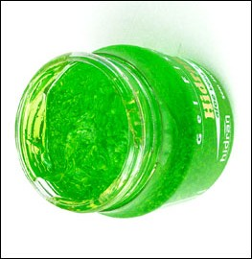
What’s your story?
Hair Gel

Slide 24
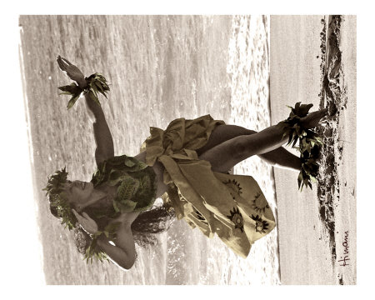
What’s your story?
Hula Dancer

Slide 25
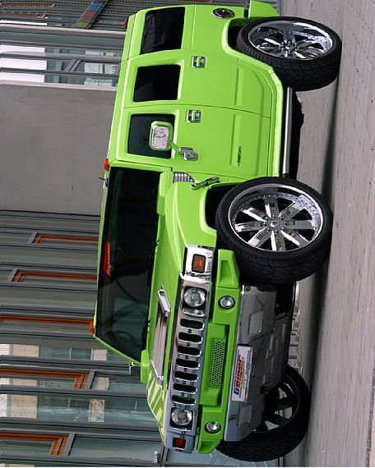
What’s your story?
Hummer

Slide 26
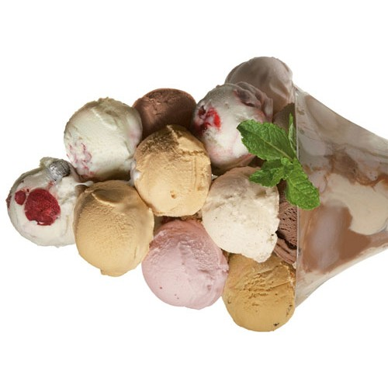
What’s your story?
Ice Cream

Slide 27

What’s your story?
Jaguar

Slide 28

What’s your story?
Jessica Alba

Slide 29
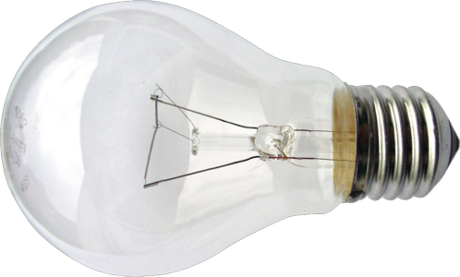
What’s your story?
Light Bulb

Slide 30
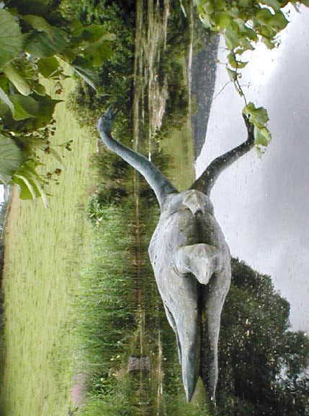
What’s your story?
Loch Ness Monster

Slide 31
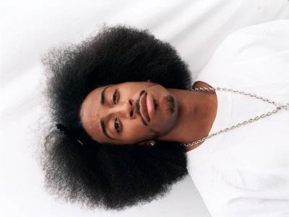
What’s your story?
Ludacris

Slide 32
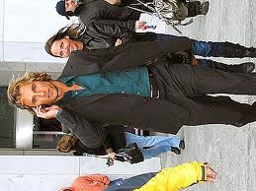
What’s your story?
Matthew McConaughey

Slide 33
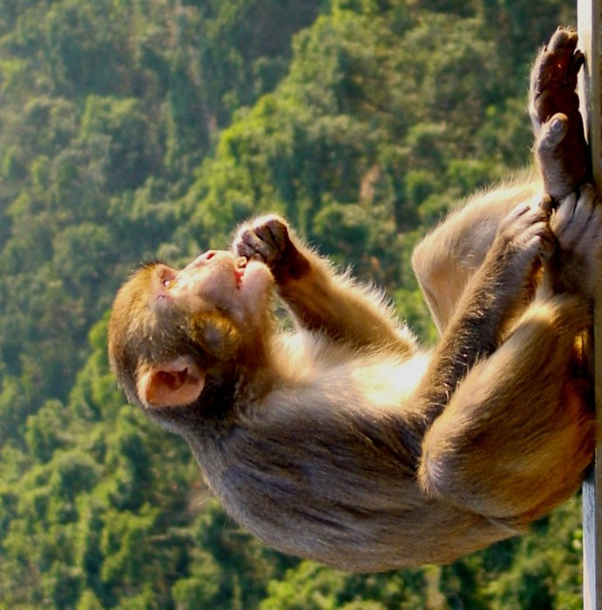
What’s your story?
Monkey

Slide 34
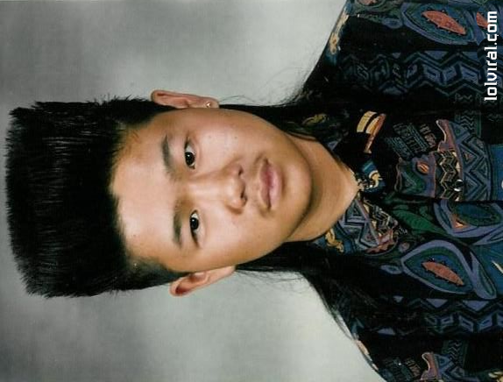
What’s your story?
Mullet

Slide 35
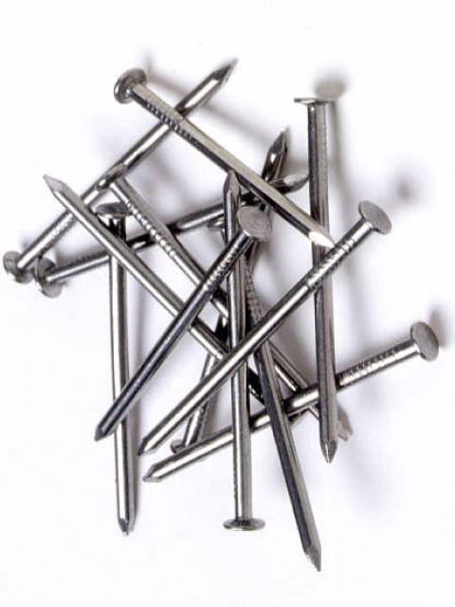
What’s your story?
Nails

Slide 36
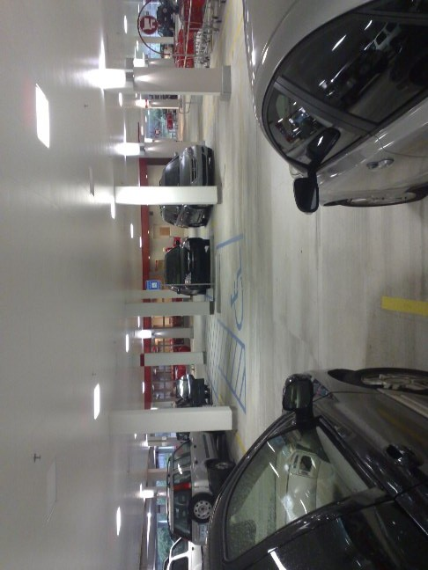
What’s your story?
Parking Deck

Slide 37
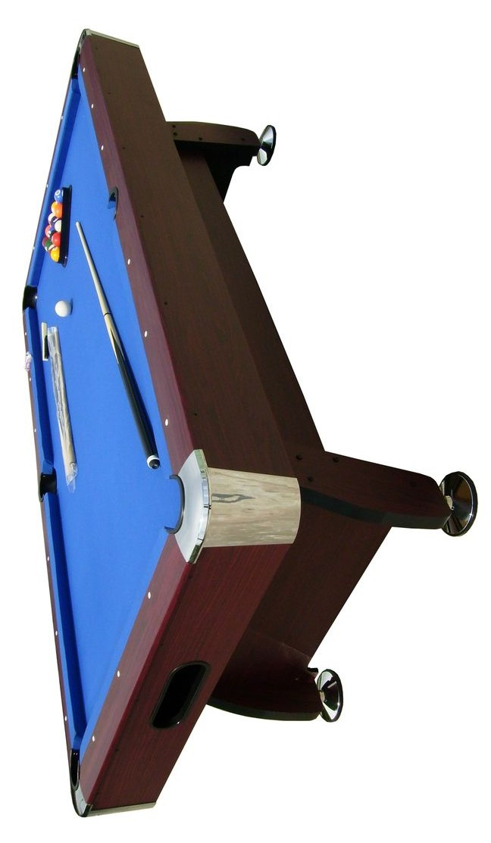
What’s your story?
Pool Table

Slide 38

What’s your story?
Puppies

Slide 39
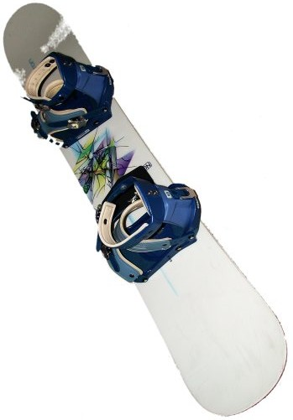
What’s your story?
Snowboard

Slide 40
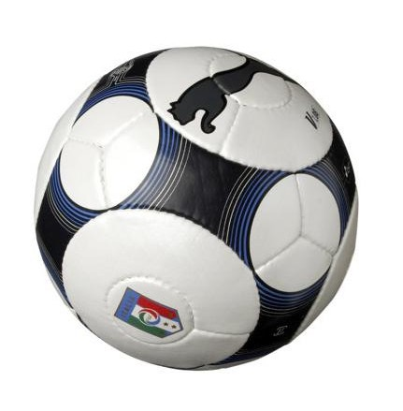
What’s your story?
Soccer Ball

Slide 41
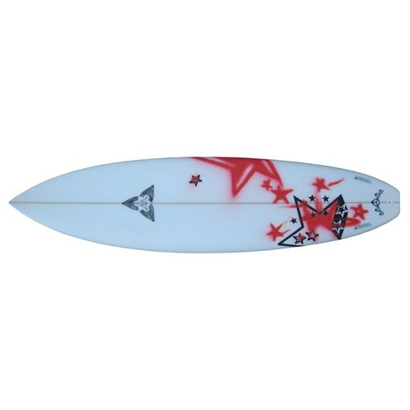
What’s your story?
Surfboard

Slide 42
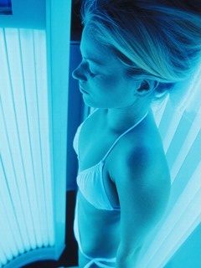
What’s your story?
Tanning

Slide 43
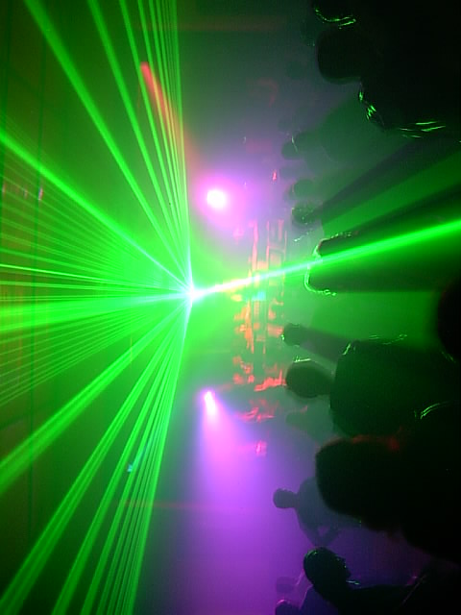
What’s your story?
Techno

Slide 44
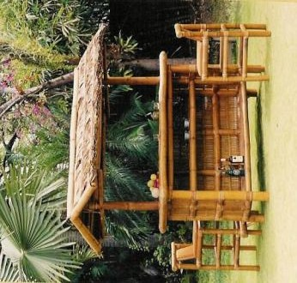
What’s your story?
Tiki Bar

Slide 45
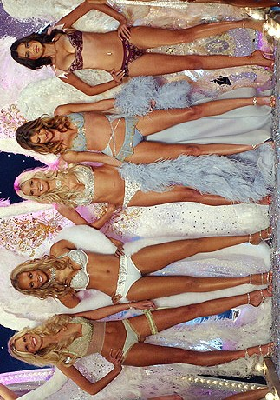
What’s your story?
Victoria’s Secret

Slide 46
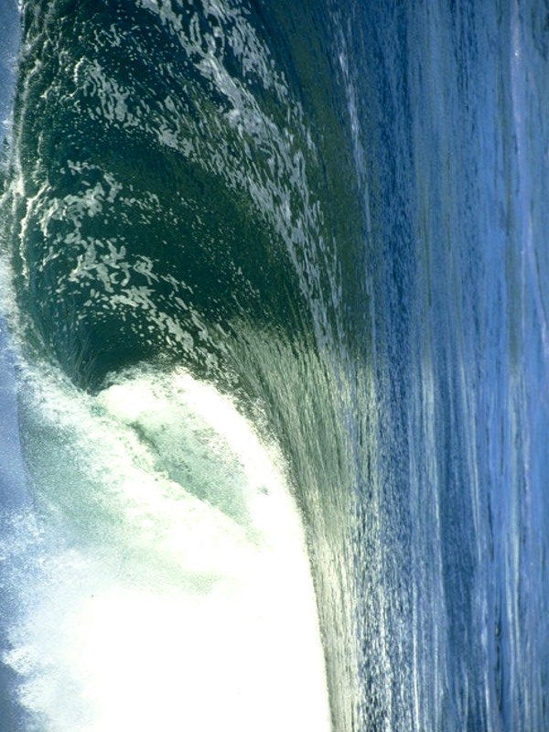
What’s your story?
Wave

Slide 47
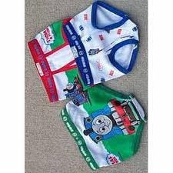
What’s your story?
Undergarments

Slide 48
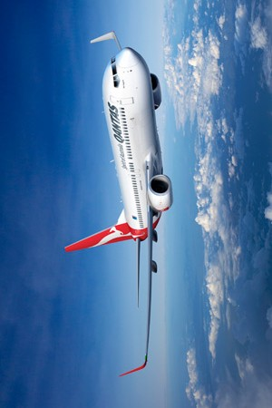
What’s your story?
Airplane

Slide 49
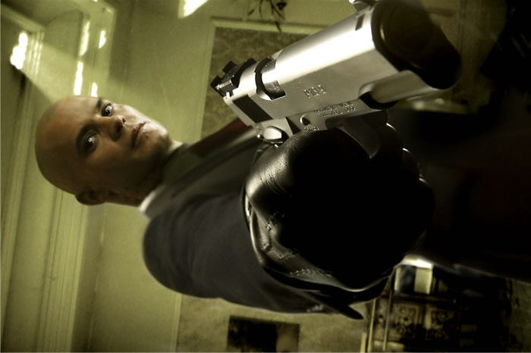
What’s your story?
Assassin

Slide 50
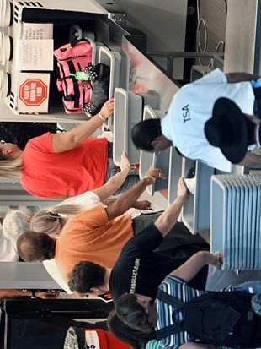
What’s your story?
Airport Security

